Slide 1







Lecture 17:
Middleware Chaining
Course - Web Development - III
-By
Pratik Raj Verma
welcome@krmangalam.edu.in
Sohna Road,Gurugram,Haryana 122103

Slide 2

| Table of Contents
Multiple Middleware
Middleware Chaining
Route-Level Middleware
References.
The End.

Slide 3

|
Imagine you are entering an airport. Do you pass only one checkpoint?
No
You go through: Security Check , Ticket Verification, Luggage Scanning, Boarding Gate, One checkpoint after another.

Slide 4
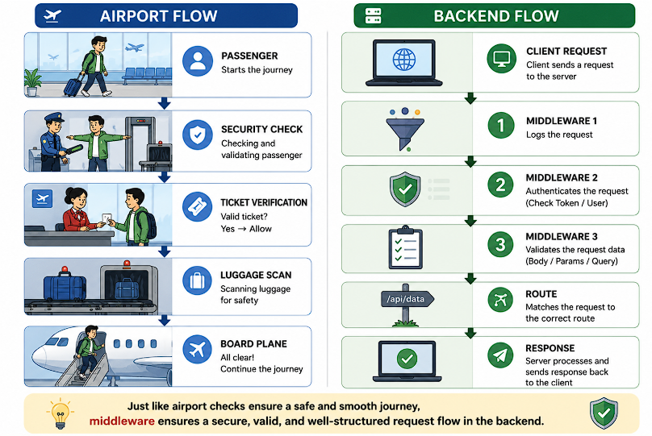
|
Can a request also pass through multiple middleware functions before reaching the controller?
Yes
This is called: Middleware Chaining

Slide 5
| Middleware Chaining?
Middleware Chaining is the process of executing multiple middleware functions in sequence before reaching the final route handler.
Each middleware performs a specific task and then passes control using: next()
Why Do We Need Middleware Chaining?
Imagine a protected application.
Before accessing data:
Log Request
Verify User
Check Permissions
Should all this happen inside one middleware?
No
Logger
↓
Authentication
↓
Authorization
↓
Controller

Slide 6
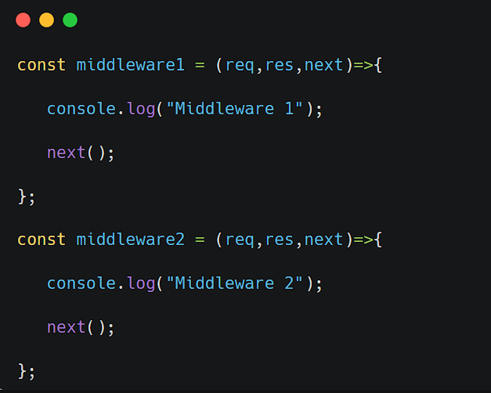
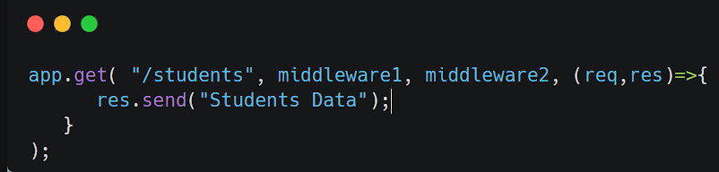
| Middleware Chaining?
Multiple Middleware Example
Client Request
↓
Middleware 1
↓
Middleware 2
↓
Route Handler
↓
Response

Slide 7
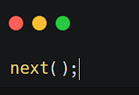
| Middleware Chaining?
next() Sequence
Every middleware must call: next();
Purpose: "Move request to the next middleware."
Without next(): Request processing stops.

Slide 8
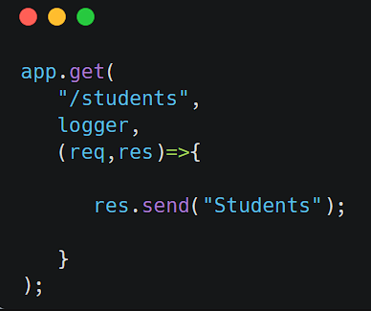
| Middleware Chaining?
Route-Level Middleware
Route-Level Middleware is a middleware function that is applied to a specific route instead of the entire application.
It executes only when that particular route is accessed.
Only this route uses logger.

Slide 9
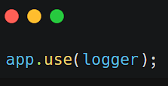
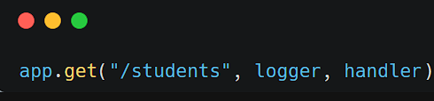
| Middleware Chaining?
Route-Level vs Global Middleware
Global Middleware | Route-Level Middleware
Runs on every request | Runs on specific route
app.use() | app.get(), app.post()
Common functionality | Route specific functionality

Slide 10
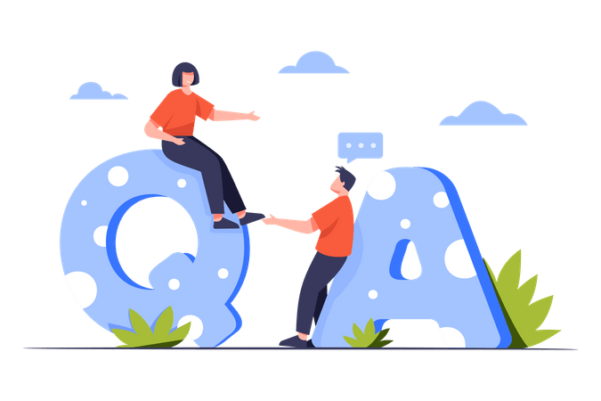
| Check Your Understanding
Question : What is Middleware Chaining?
Options : A. Executing multiple routes together
B. Executing multiple middleware functions in sequence
C. Connecting multiple servers
D. Creating multiple controllers
Answer : B. Executing multiple middleware functions in sequence
Explanation:
Middleware Chaining means one middleware executes after another before reaching the route handler.

Slide 11
| Check Your Understanding
Question : What is the purpose of next() in Express middleware?
Options : A. Stop the server
B. Send response to client
C. Pass control to the next middleware or route
D. Create a new route
Answer : C. Pass control to the next middleware or route
Explanation:
next() tells Express:
"My work is finished, continue processing the request."
Without next(), the request stops.

Slide 12
| Check Your Understanding
Question : What is Route-Level Middleware?
Options : A. Middleware that runs on every request
B. Middleware attached to a specific route
C. Middleware used only for databases
D. Middleware used only for authentication
Answer : B. Middleware attached to a specific route
Explanation:
Route-Level Middleware runs only for a particular route.

Slide 13
| References
MDN Web Docs : Comprehensive and official documentation for Express Js 🔗https://developer.mozilla.org/en-US/docs/Learn_web_development/Extensions/Server-side/Express_Nodejs
W3Schools : Beginner-friendly express tutorials with examples and interactive editors. 🔗https://www.w3schools.com/nodejs/nodejs_express.asp
Express Official- A comprehensive tutorial-style website that covers core Express JS concepts in depth.
🔗https://expressjs.com/en/

Slide 14
Thanks
For
Watching
Course - Web Development - III
welcome@krmangalam.edu.in
Sohna Road,Gurugram,Haryana 122103

